Slide 1

Health Care Analytics

Slide 2
Team Members
Kiran
Prashant
Madhuri
Sailaja
Vaishnavi
Chaitanya
Sarita

Slide 3
Objectives
Health care analysis is useful to determine and analyze key health indicators such as morbidity, mortality, and disease prevalence to understand the health status of the population.
Assess patient outcomes and satisfaction to gauge the quality of healthcare services and identify areas for improvement.
Examine the accessibility of healthcare services, including geographic distribution, availability of healthcare facilities, and barriers to access.
Anticipate and analyze emerging trends in healthcare, including technological advancements, demographic shifts, and policy changes, to help stakeholders prepare for the future.
Based on the analysis, provide actionable recommendations for improving healthcare delivery, efficiency, and outcomes.

Slide 4
Health Care Analytics
Project Details :
The scope of the healthcare analysis project focuses on providing a comprehensive understanding of the distribution, types, and characteristics of hospitals in a specified geographic area. The analysis encompasses various dimensions to support informed decision-making and strategic planning within the healthcare sector.
Project Deliverables:
Geographical Maps: Visual representation of hospital distribution across the specified geographic area.
Categorization Reports: Reports detailing the types and ownership distribution of hospitals.
Emergency Services Report: A report indicating the percentage of hospitals providing emergency services.
Overall Rating Summary: Summary report of overall hospital ratings, highlighting notable trends.
Measure Group Analysis Reports: Detailed reports for each measure group, providing insights and recommendations.

Slide 5
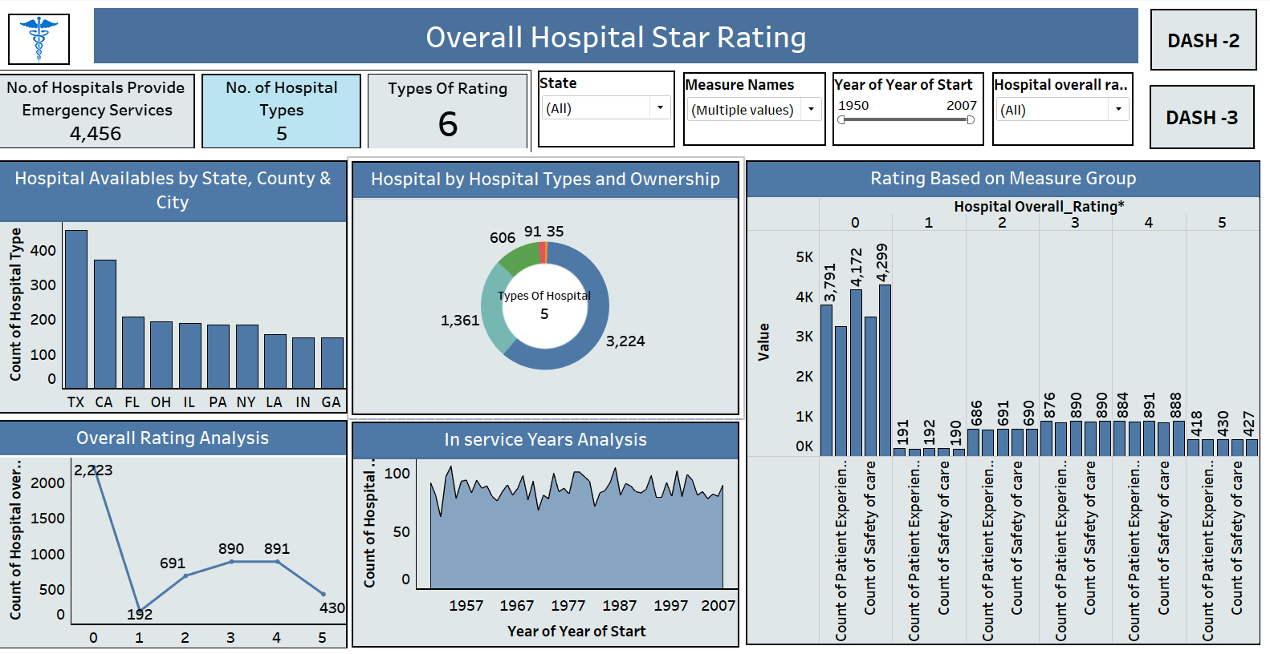
Overall Hospital Star Rating Dashboard :
Key Points :
No. of hospitals that provide
emergency services are 4456.
Count of hospital ownership for
Acute care hospital is maximum – 3224.
Count of hospitals with zero ratings
are maximum – 2223
Count of hospitals with 5 ratings are
Minimum – 430
Count of hospitals for the year 1950 is 92
Count of hospitals for the year 2007 is 90

Slide 6
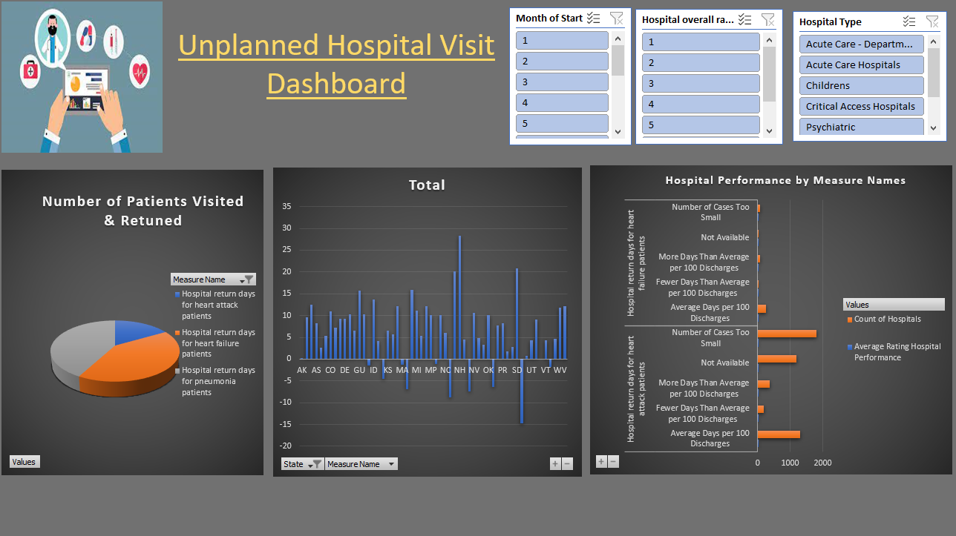
Unplanned Hospital Visit Dashboard :
Key Points :
Frequency & Trends: Information on the
frequency of unplanned hospital visits over
time, allowing healthcare professionals to
identify patterns and trends.
Readmission Rates: Information
on patients who are readmitted shortly after
discharge, which can indicate potential
issues in post-discharge care.
Geographical Analysis: Identifying
regions with higher rates of unplanned
hospital visits can aid in resource allocation
and targeted interventions.
Patient Satisfaction and Experience:
Assessing patient feedback and experiences
related to unplanned visits to improve the
overall quality of care.

Slide 7
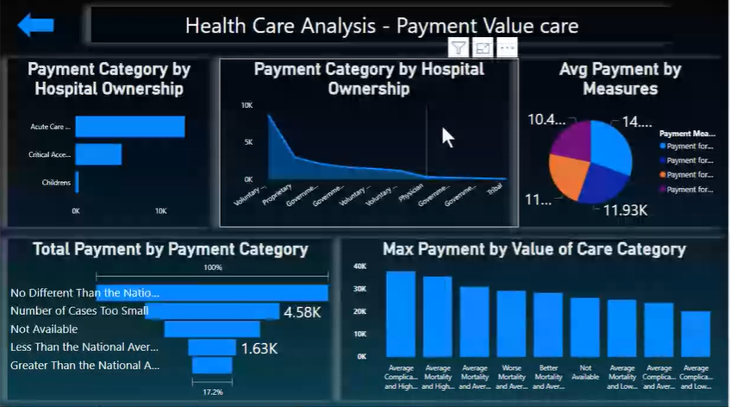
Payment Value Care Dashboard
Key Points :
Cost Analysis: Breakdown of costs
associated with specific treatments
or procedures, helping identify areas
for cost reduction or optimization
Quality Measures: Evaluation of
healthcare quality measures, adherence
to best practices, and compliance with
quality standards.
Quality Measures: Evaluation of
healthcare quality measures, adherence
to best practices, and compliance with
quality standards.

Slide 8
Conclusion
Our comprehensive analysis of the healthcare sheds light on crucial aspects of hospital distribution, types, and performance.
The geographical mapping of hospitals has revealed distinct patterns in their distribution across states, counties, and cities. This information provides a foundation for understanding the accessibility and potential gaps in healthcare services.
Our categorization of hospitals based on types and ownership highlights the diverse range of healthcare providers in the region. This knowledge is vital for strategic planning, resource allocation, and fostering collaboration among different stakeholders.
The overall rating analysis offers a snapshot of the general quality of healthcare in our specified area. This insight can guide patients in making informed decisions and assist healthcare administrators in prioritizing areas for improvement.
The assessment of emergency services provision has identified areas where urgent healthcare needs are met promptly. This information is crucial for ensuring that communities have access to life-saving services when needed the most.
In conclusion, this healthcare analysis project serves as a valuable resource for all stakeholders invested in the well-being of our community. By understanding the current state of healthcare and leveraging the insights gained, we can collectively work towards a healthier and more resilient healthcare system.

Slide 9
Health Care Analytics
Thank You …!!!!

